Slide 1
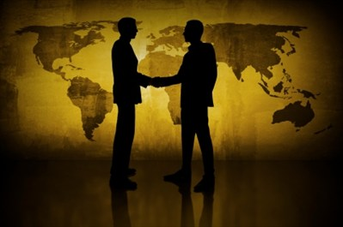
USA Etiquette

Slide 2
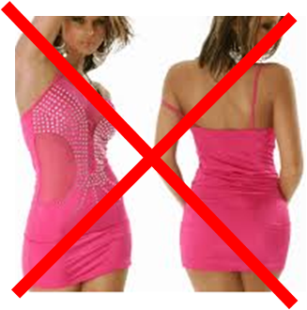
Business Etiquette and Protocol

Slide 3
Business Dress What is considered appropriate business attire varies by geographic region, day of the week and industry.
In general, people in the East dress more formally, while people in the West are known for being a bit more casual.
Executives usually dress formally regardless of which part of the country they are in.
Casual Friday is common in many companies. High technology companies often wear casual clothes every day.
For an initial meeting, dressing conservatively is always in good taste. Women can wear business suits, dresses or pantsuits. Men should wear a business suit unless you know the firm to be quite casual.

Slide 4
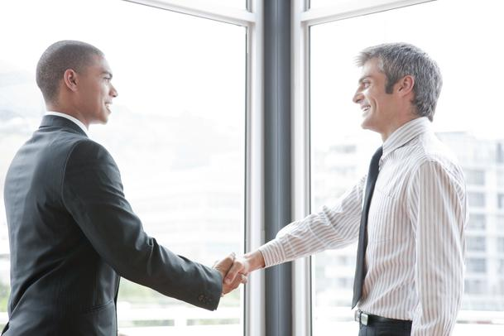

Slide 5
Greetings The hand shake is the common greeting.
Handshakes are firm, brief and confident.
Maintain eye contact during the greeting.
In most situations, you can begin calling people by their first names.
Most people will insist that you call them by their nickname, if they have one.
In formal circumstances, you may want to use titles and surnames as a courtesy until you are invited to move to a first name basis, which will happen quickly.
Business cards are exchanged without formal ritual.
It is quite common for the recipient to put your card in their wallet, which may then go in the back pocket of their trousers. This is not an insult.

Slide 6
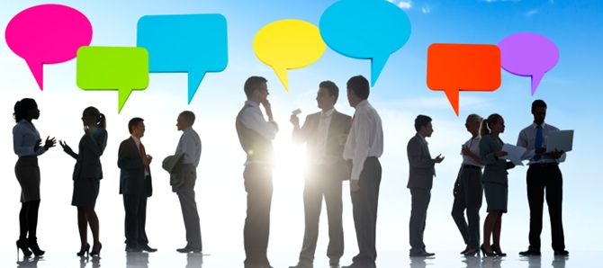

Slide 7
Communication Styles
Americans are direct. They value logic and linear thinking and expect people to speak clearly and in a straightforward manner. To them if you don’t “tell it how it is” you simply waste time, and time is money. If you are from a culture that is more subtle in communication style, try not to be insulted by the directness. Try to get to your point more quickly and don’t be afraid to be more direct and honest than you are used to. Americans will use the telephone to conduct business that would require a face-to-face meeting in most other countries. They do not insist upon seeing or getting to know the people with whom they do business.

Slide 8
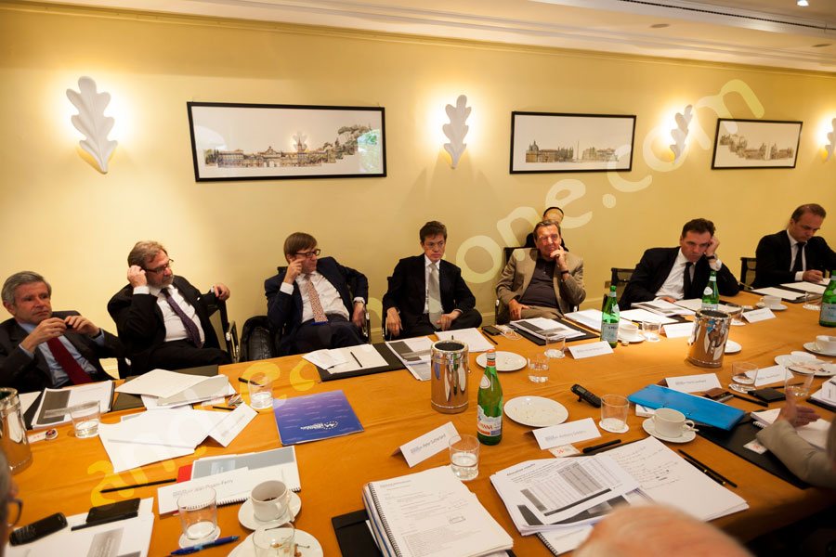
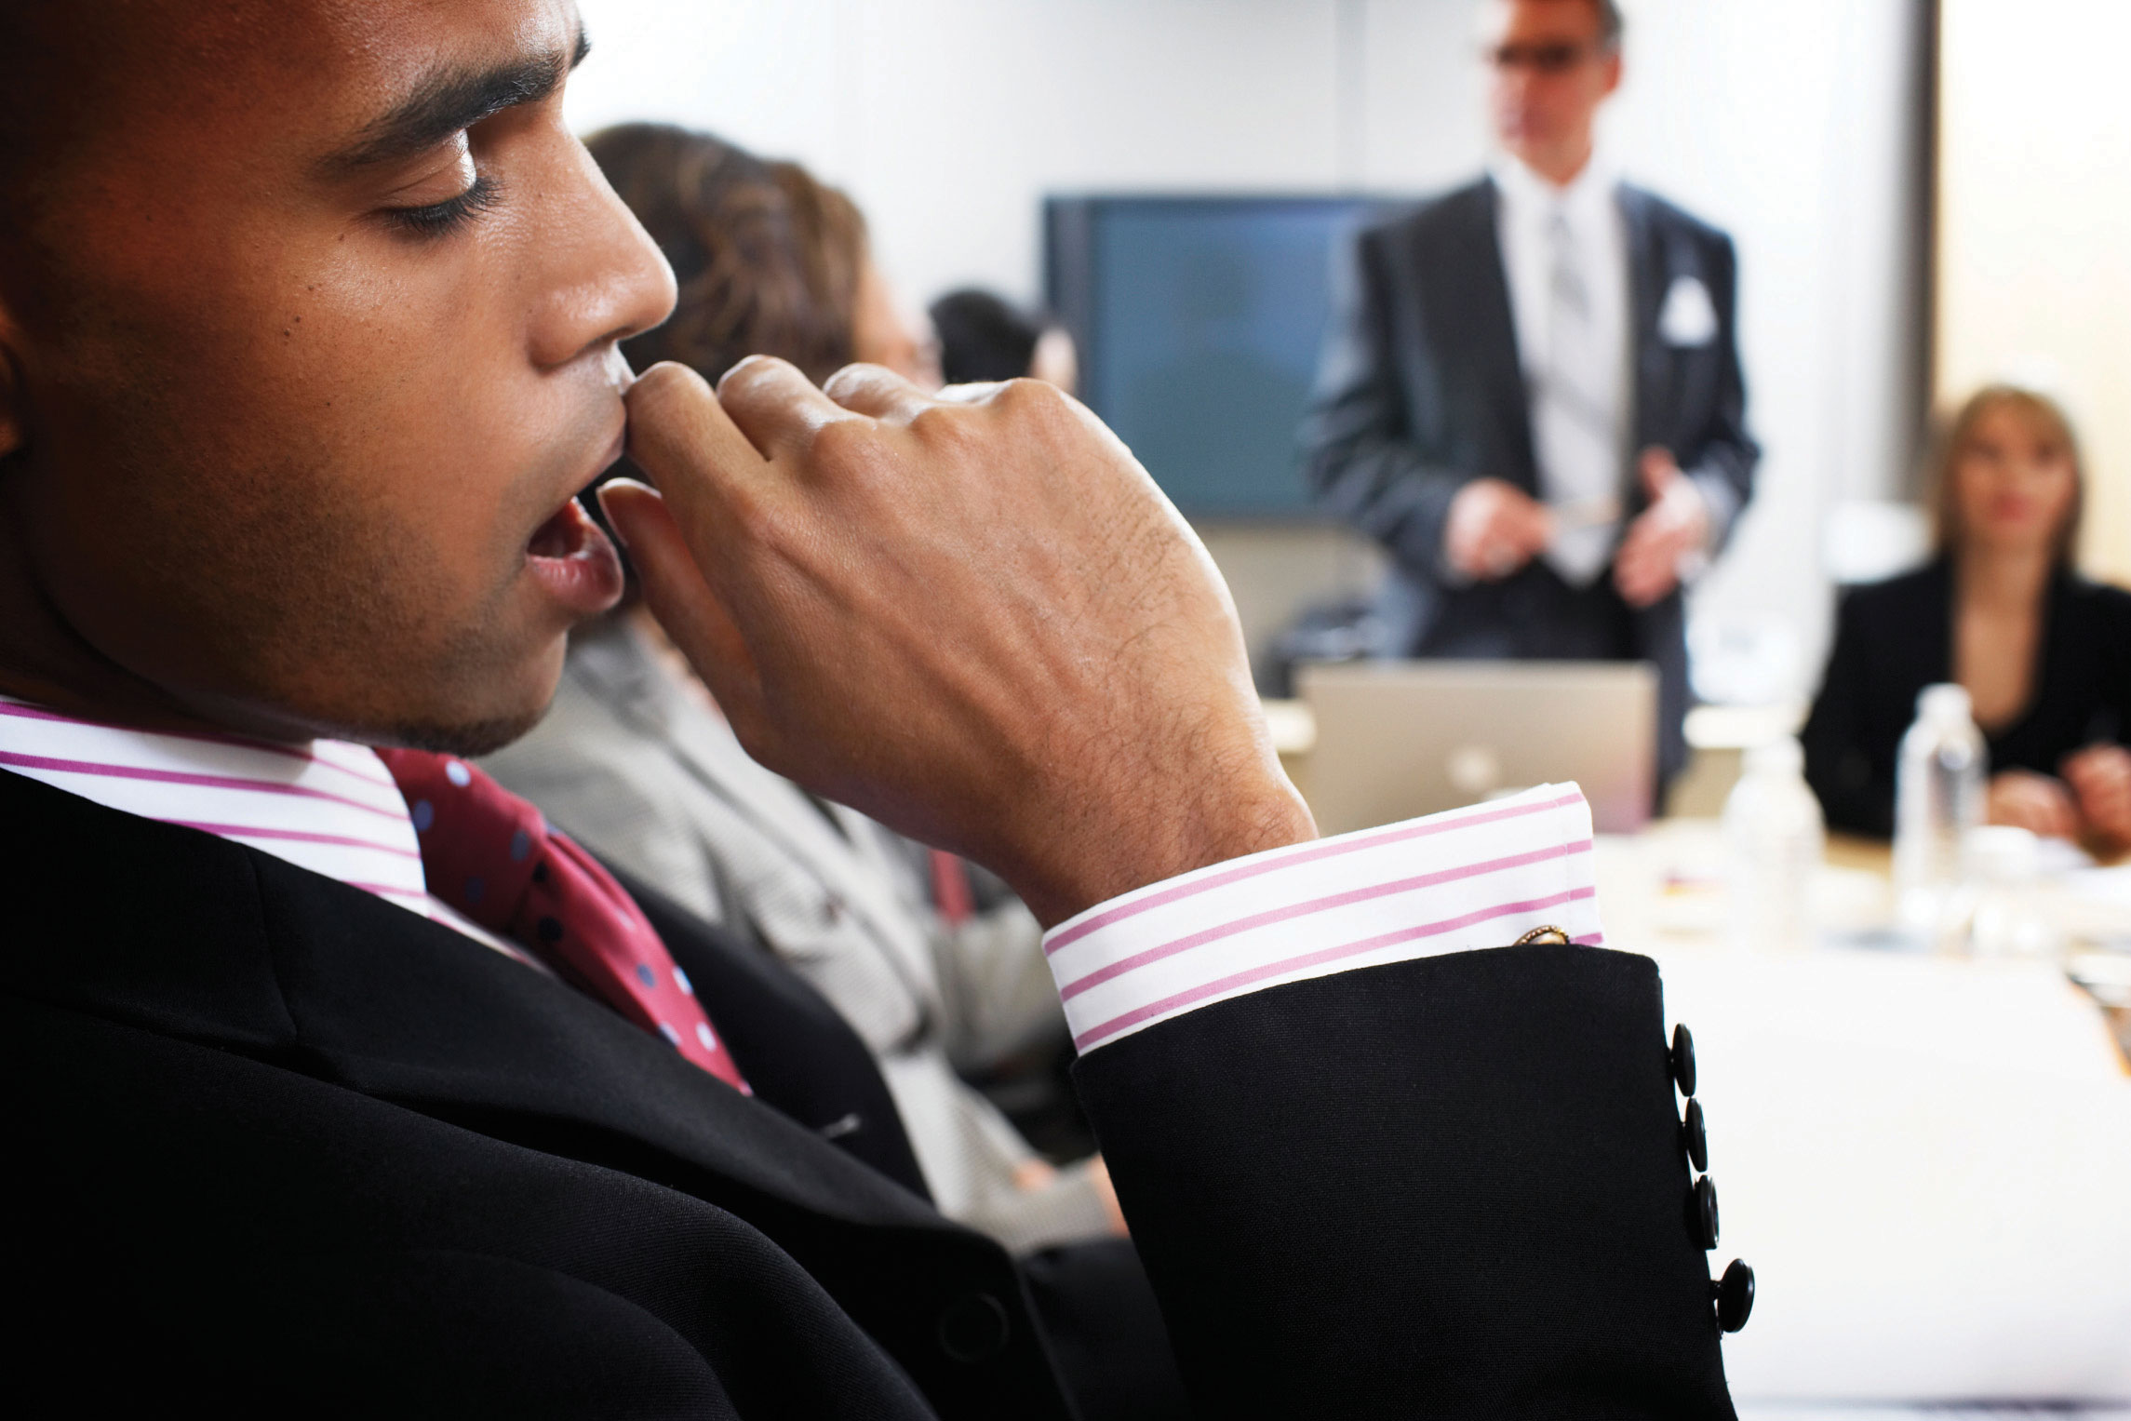

Slide 9
Business Meetings Arrive on time for meetings since time and punctuality are so important to Americans. In the Northeast and Midwest, people are extremely punctual and view it as a sign of disrespect for someone to be late for a meeting or appointment. In the Southern and Western states, people may be a little more relaxed, but to be safe, always arrive on time, although you may have to wait a little before your meeting begins. Meetings may appear relaxed, but they are taken quite seriously. If there is an agenda, it will be followed. At the conclusion of the meeting, there will be a summary of what was decided, a list of who will implement which facets and a list of the next steps to be taken and by whom. If you make a presentation, it should be direct and to the point. Visual aids should further enhance your case. Use statistics to back up your claims, since Americans are impressed by hard data and evidence. With the emphasis on controlling time, business is conducted rapidly. Expect very little small talk before getting down to business. It is common to attempt to reach an oral agreement at the first meeting. The emphasis is on getting a contract signed rather than building a relationship. The relationship may develop once the first contract has been signed.

