Slide 1
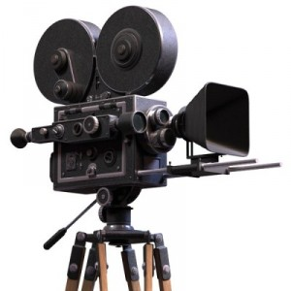
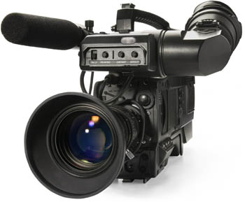
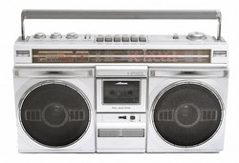
Mass Media
by Gurina Vicktoria
Form 11-a
School №20

Slide 2
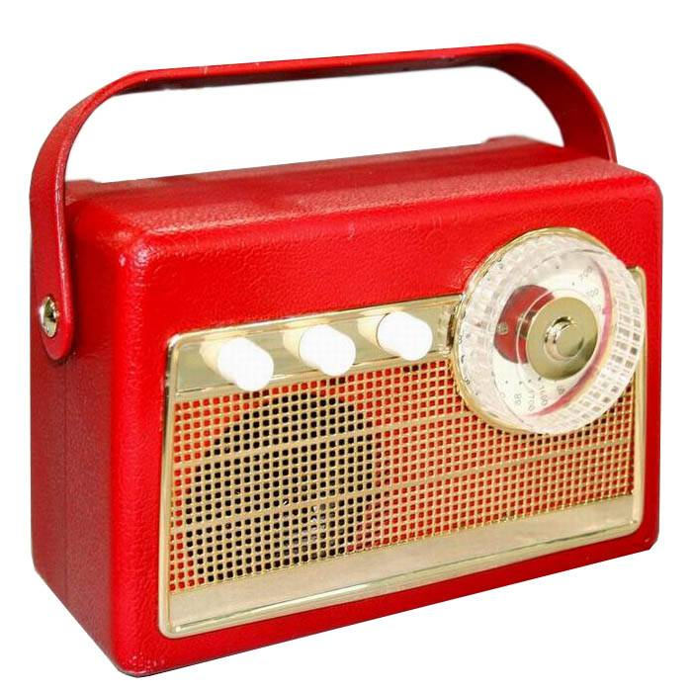
The mass media…
The mass media play an important part in our lives. Newspaper, radio and espeially TV inform us of what is going on in this world and give us wonderful possibilities for education and entertainment.

Slide 3
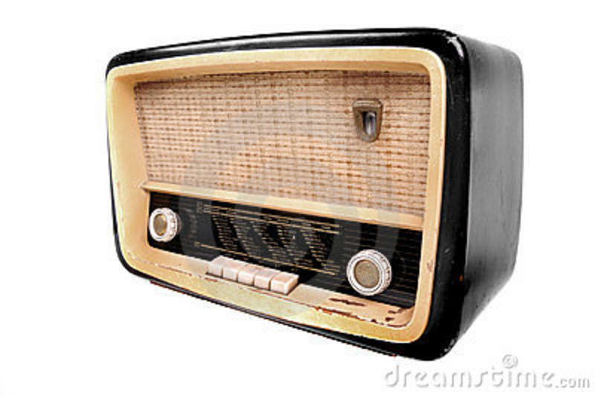
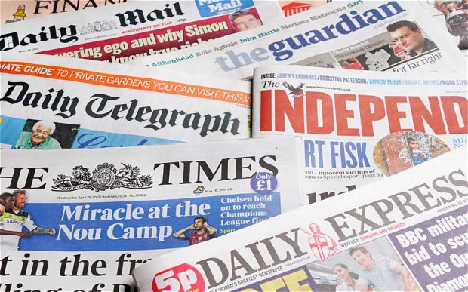
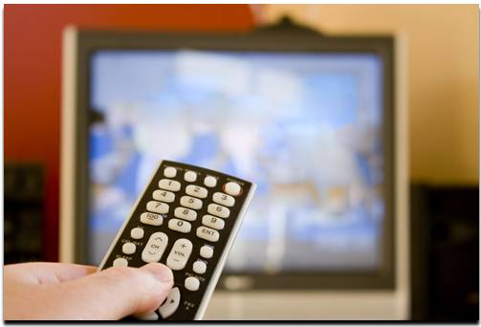
What Is the Mass Media?
MAGAZINES
INTERNET
RADIO
TELEVISION
NEWSPAPERS

Slide 4
Of course, not all newspapers and TV programmes report the events objectively, but serious journalists and TV reporters try to be fair and provide us with reliable information.

Slide 5
It is true that the world today is full of dramatic events and most news seems to be bad news. But people aren’t interested in ordinary events.
That is why there are so many programmes and articles about natural disasters, plane crashes, wars, murders and robberies.

Slide 6
Some people say that journalists are given too much freedom. They often intrude on people’s private lives. They follow celebrities and print sensational stories about them which are untrue or half-true.

Slide 7
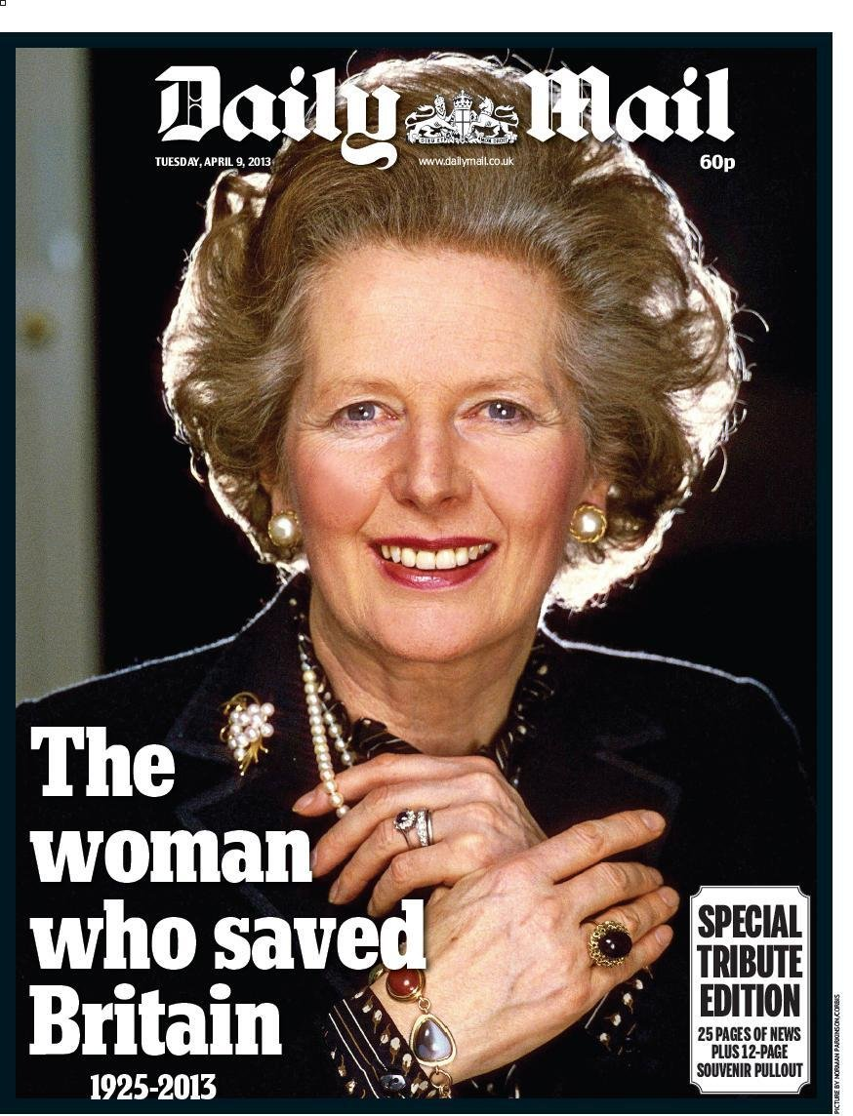
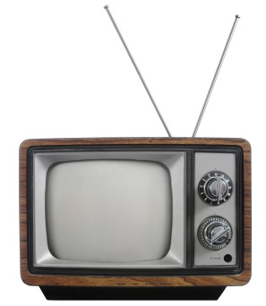
The main source of news for millions of people is television. People like TV news because they can see everything with their own eyes. Besides, it’s much more difficult for politicians to lie in front of the cameras than on the pages of newspapers.

Slide 8
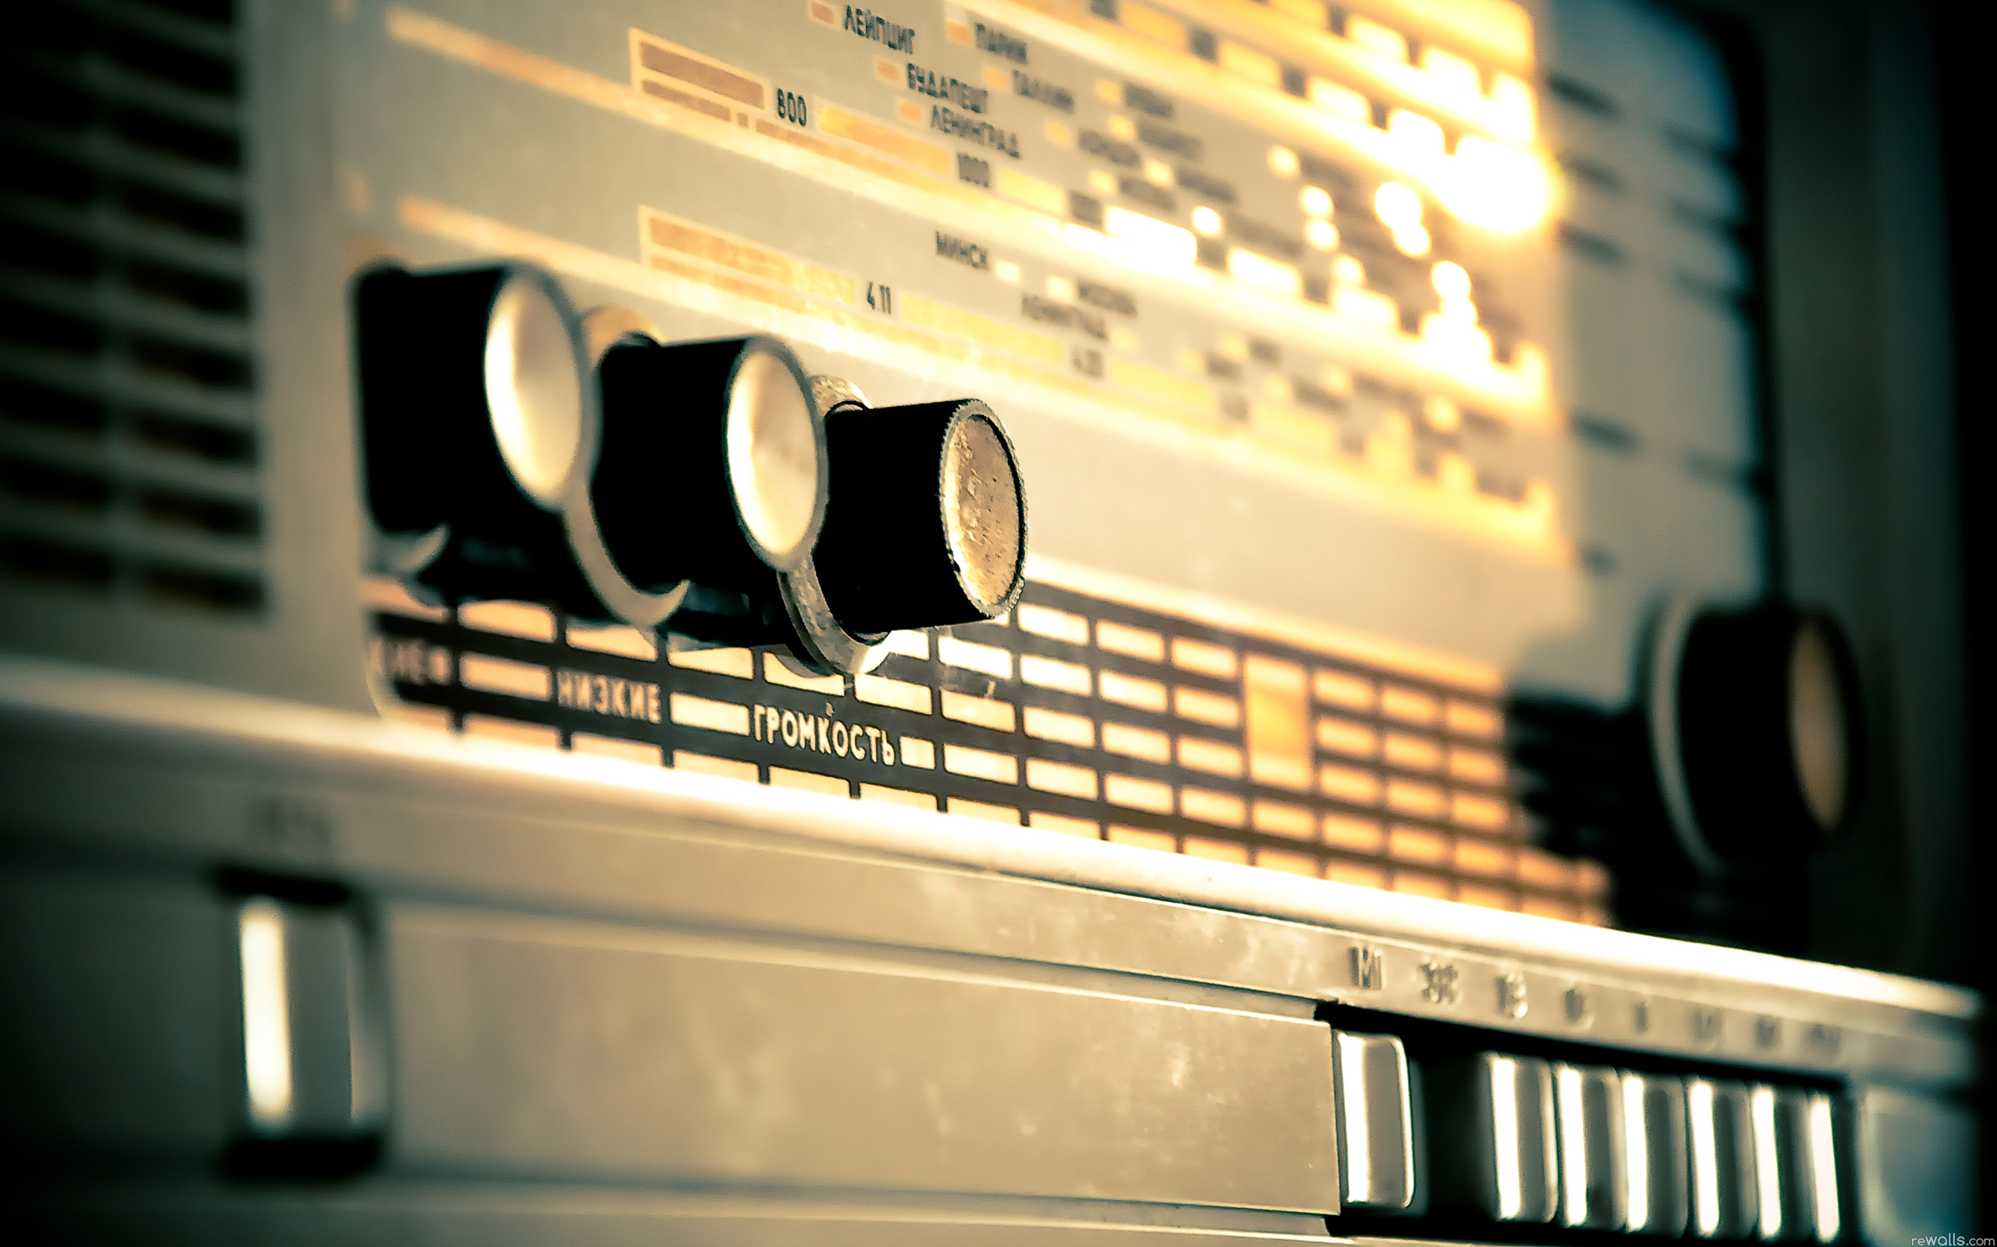
Still, many people prefer the radio. It’s good to listen to in the car, or in the open air, or when you do something about the house.

Slide 9
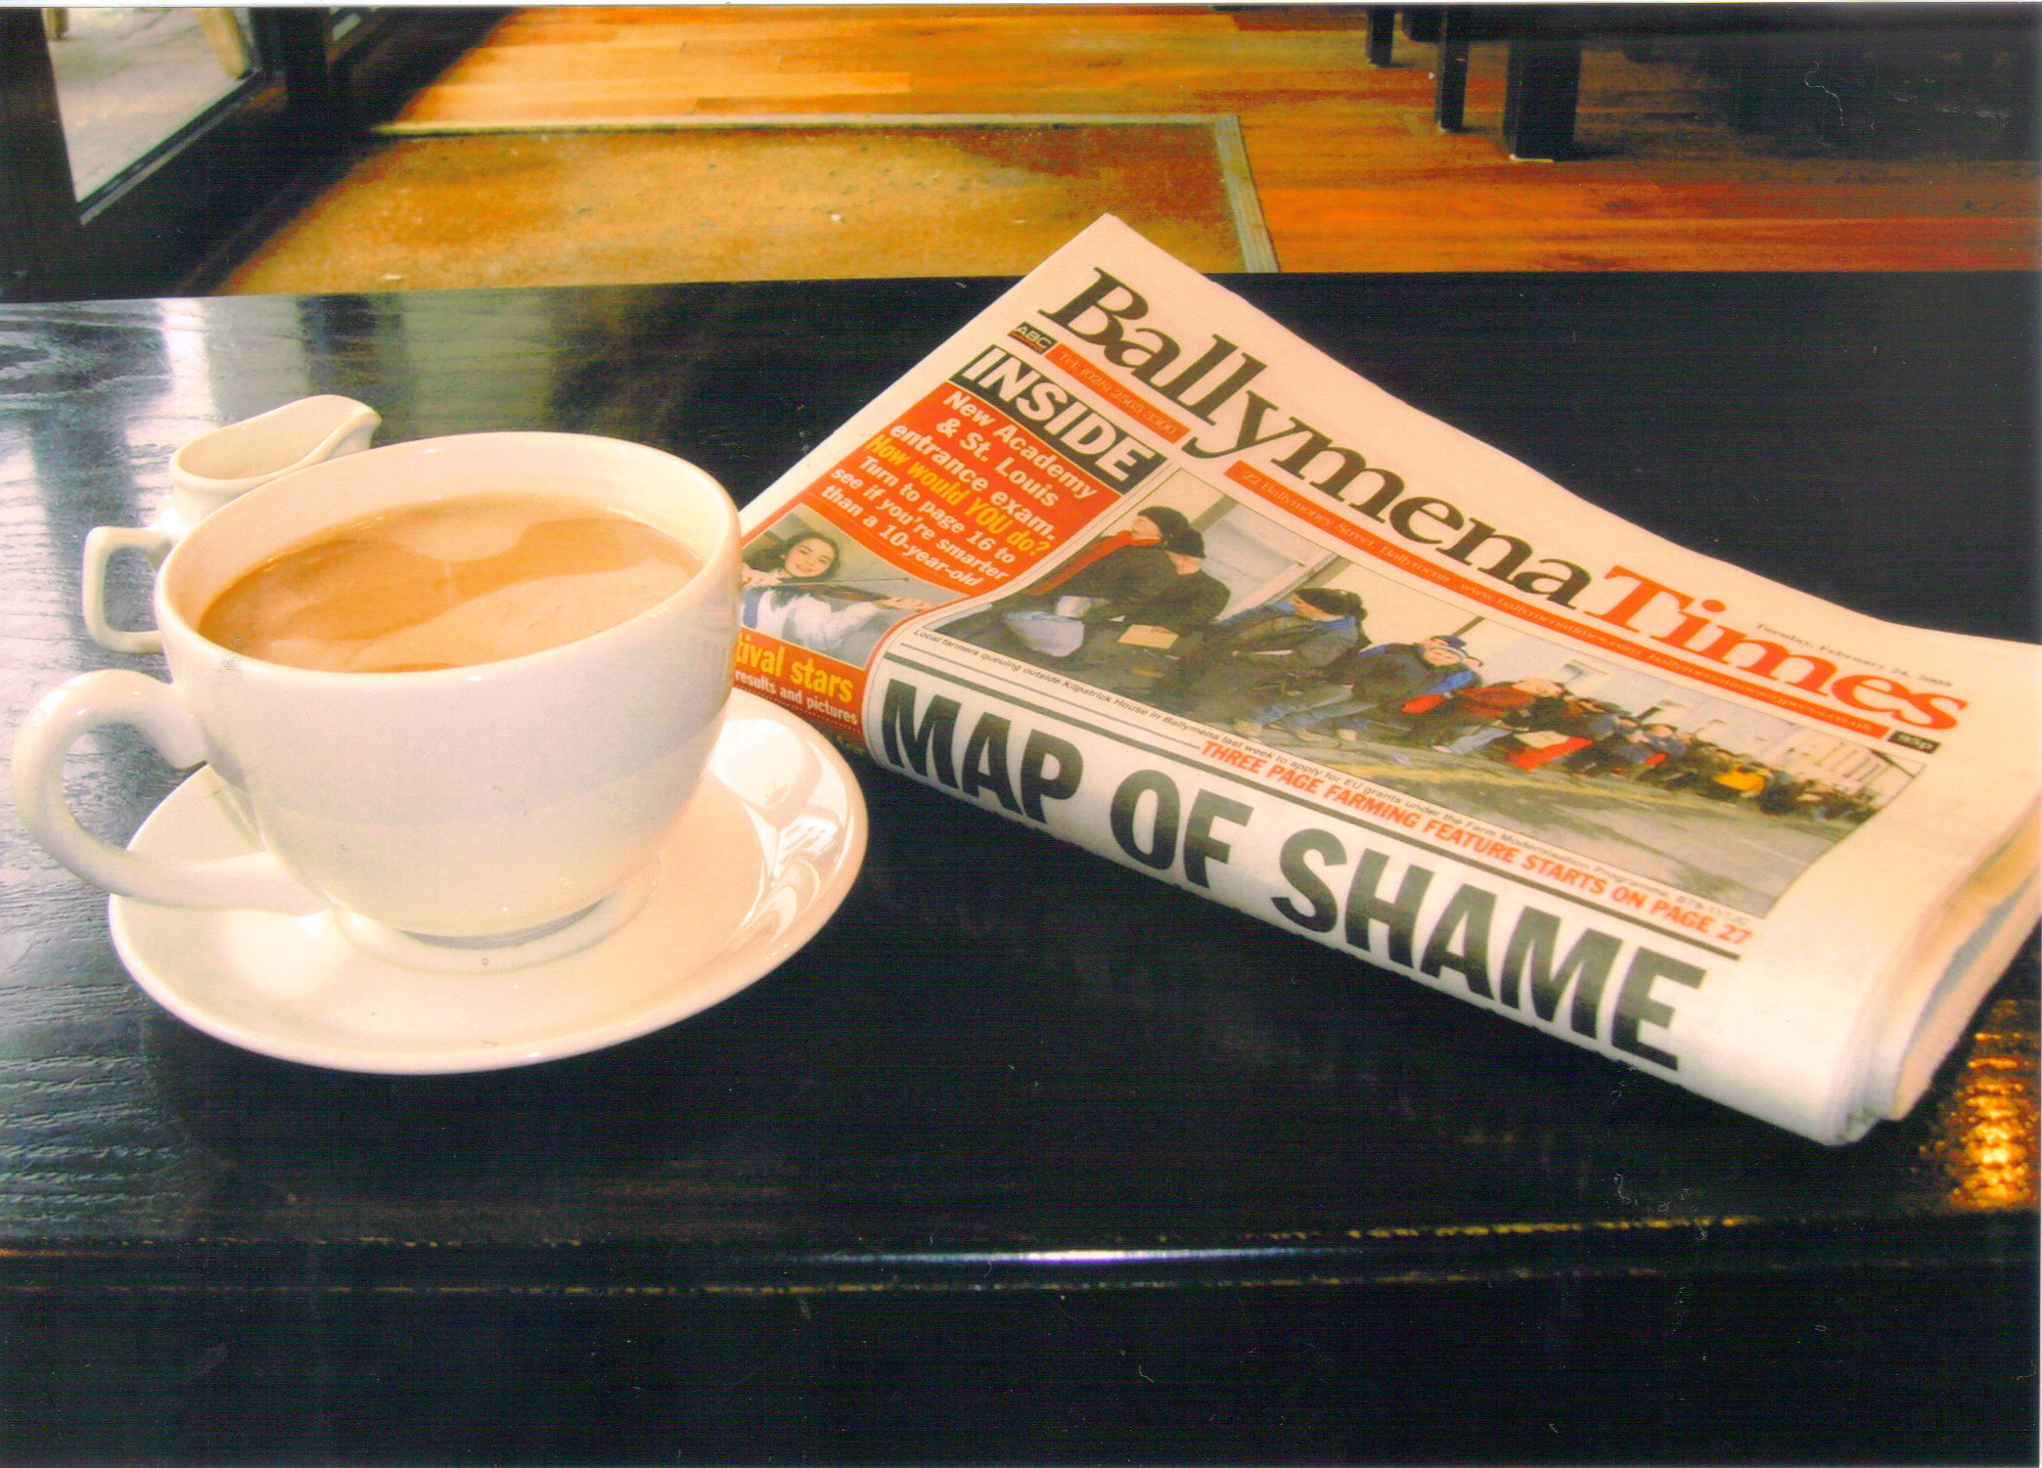
Newspapers don’t react to events as quickly as TV, but they usually provide us with background information.

Slide 10
The Internet has recently become another important source of information. Its main advantage is that news appears on the screen as soon as things happen in real life and you don’t have to wait for news time on TV.

Slide 11
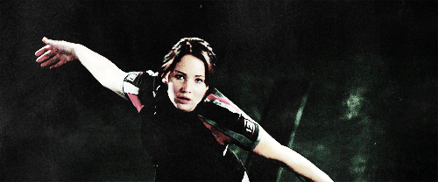
Thank you. Thank you for your consideration)

