Slide 1
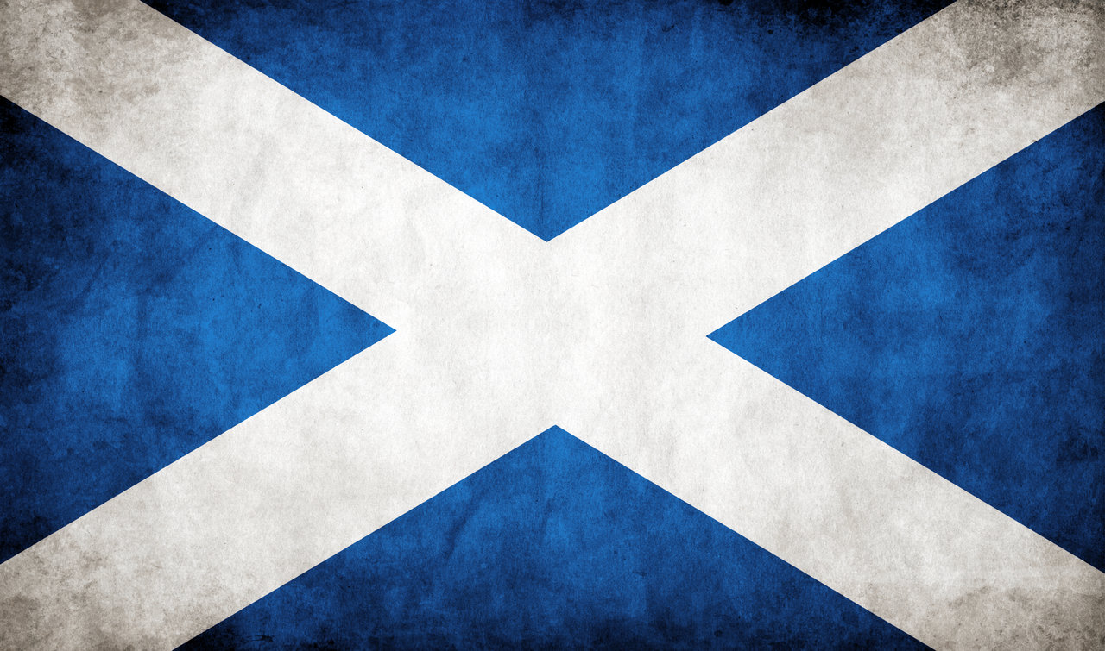
Scotland

Slide 2
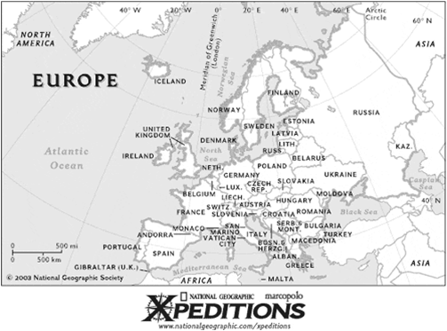
Where is Scotland?

Slide 3
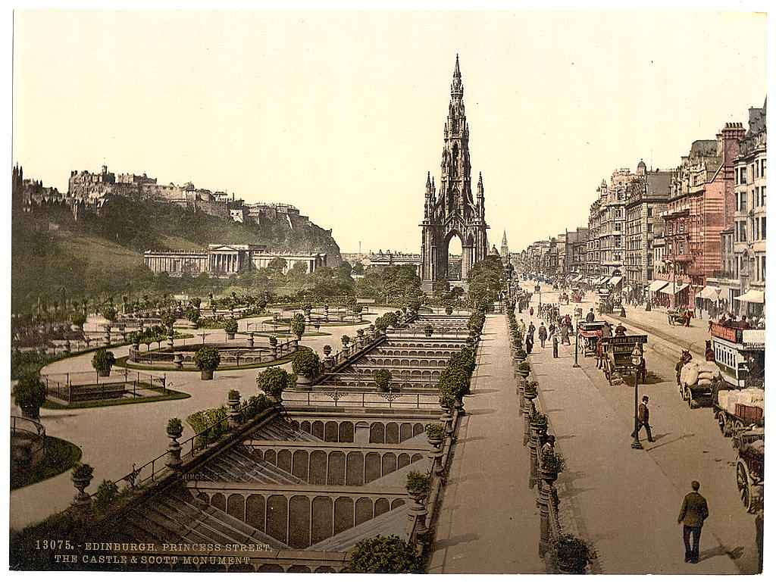
History of Scotland

Slide 4
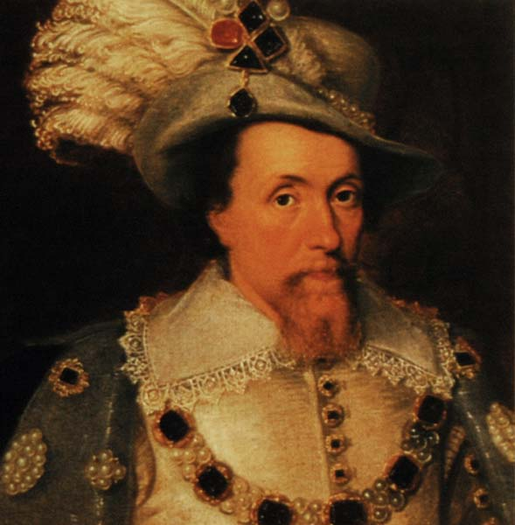
King James VI

Slide 5
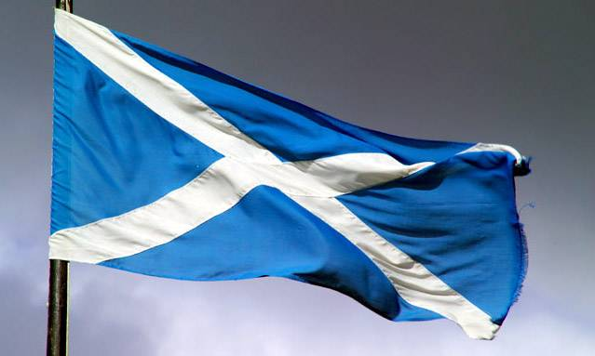
Flag of Scotland

Slide 6
Scotland
the Highlands Lowlands Southern Uplands

Slide 7
A Few Facts About Scotland
The capital of Scotland is Edinburgh.
The money used is called the pound sterling.
The population of Scotland is 4,996,000.
The language spoken is English.

Slide 8
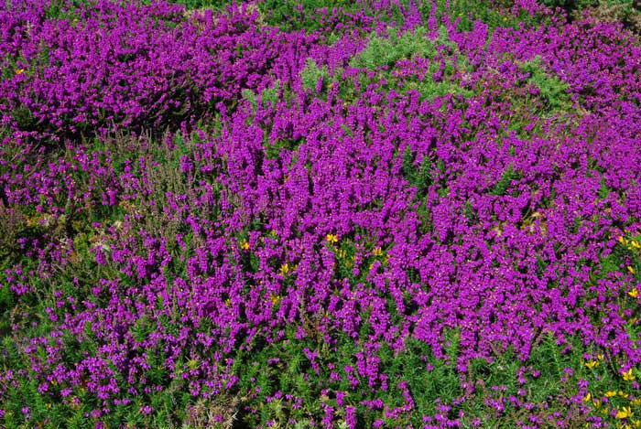
Scotland is a fascinating country.

Slide 9
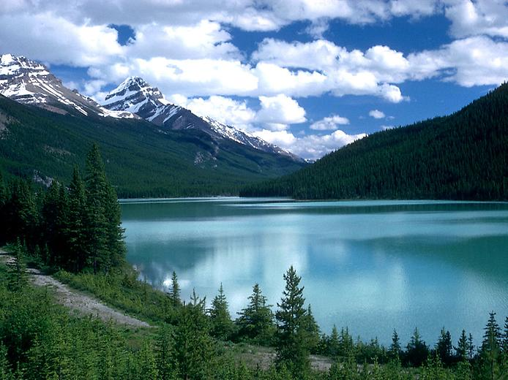
Lochs

Slide 10
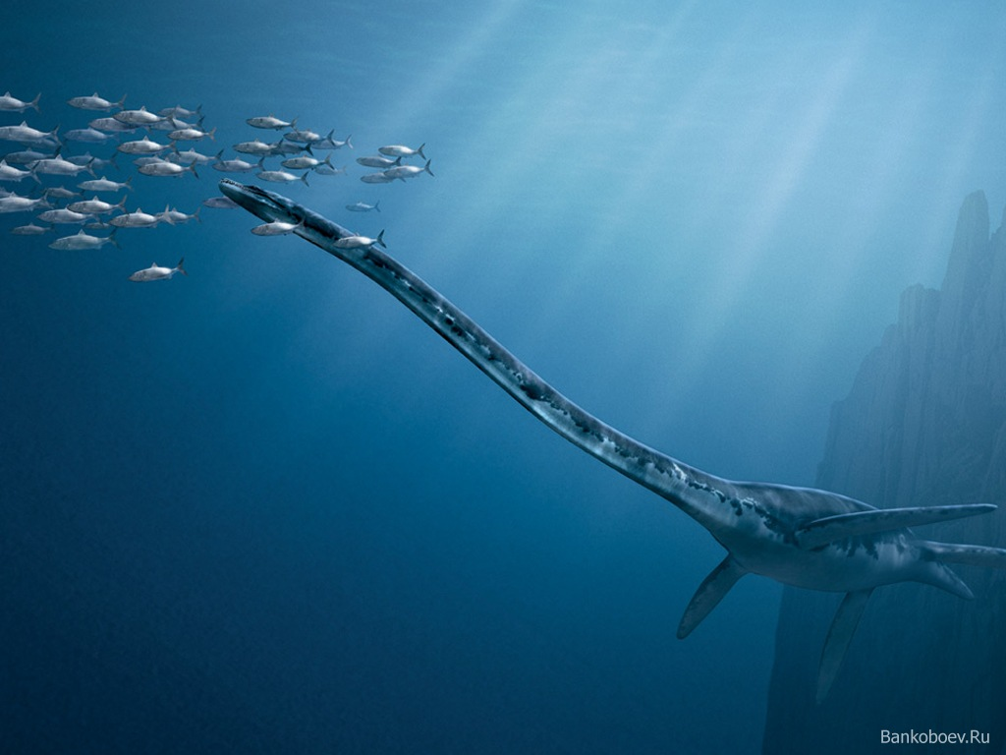

Slide 11
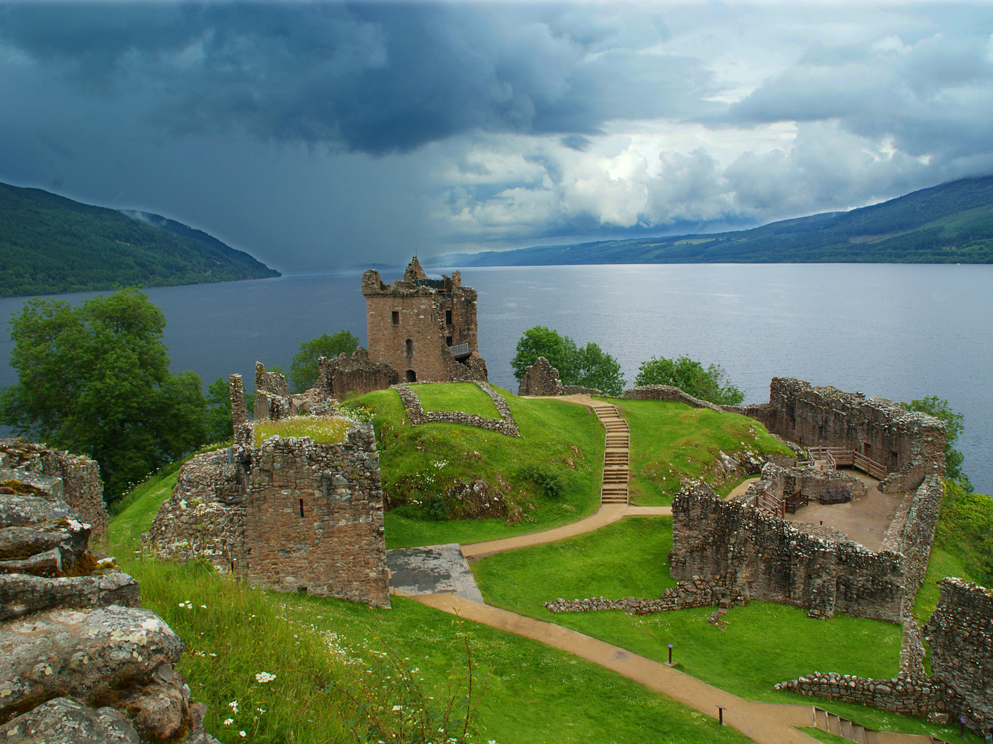

Slide 12
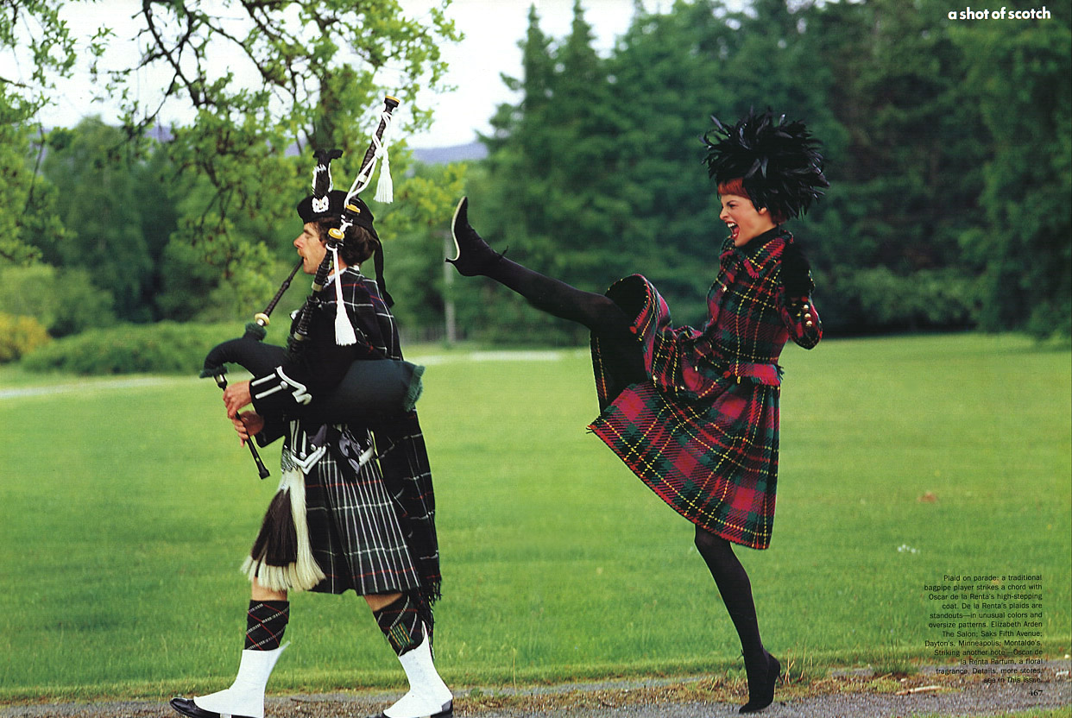

Slide 13
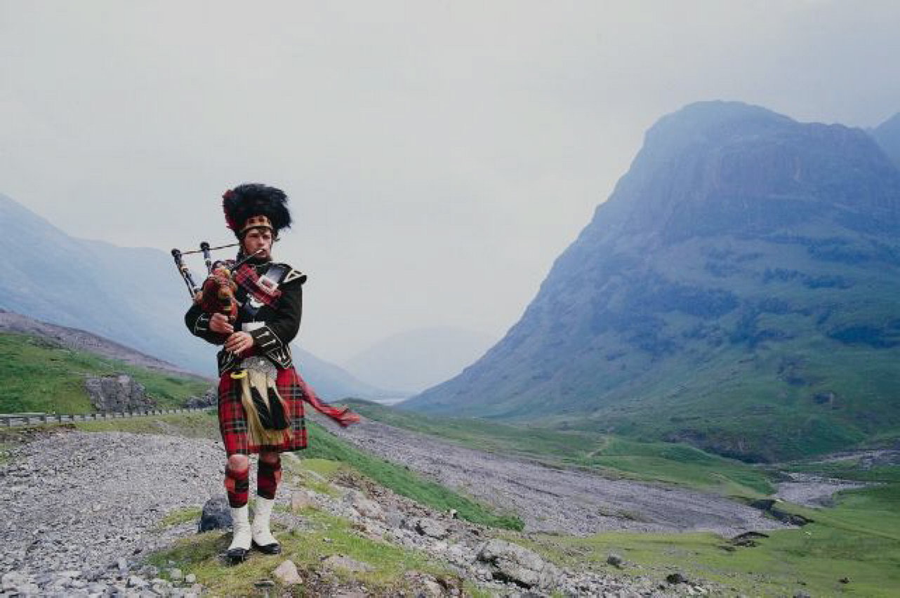
Scotland is a land of many famous people…

Slide 14
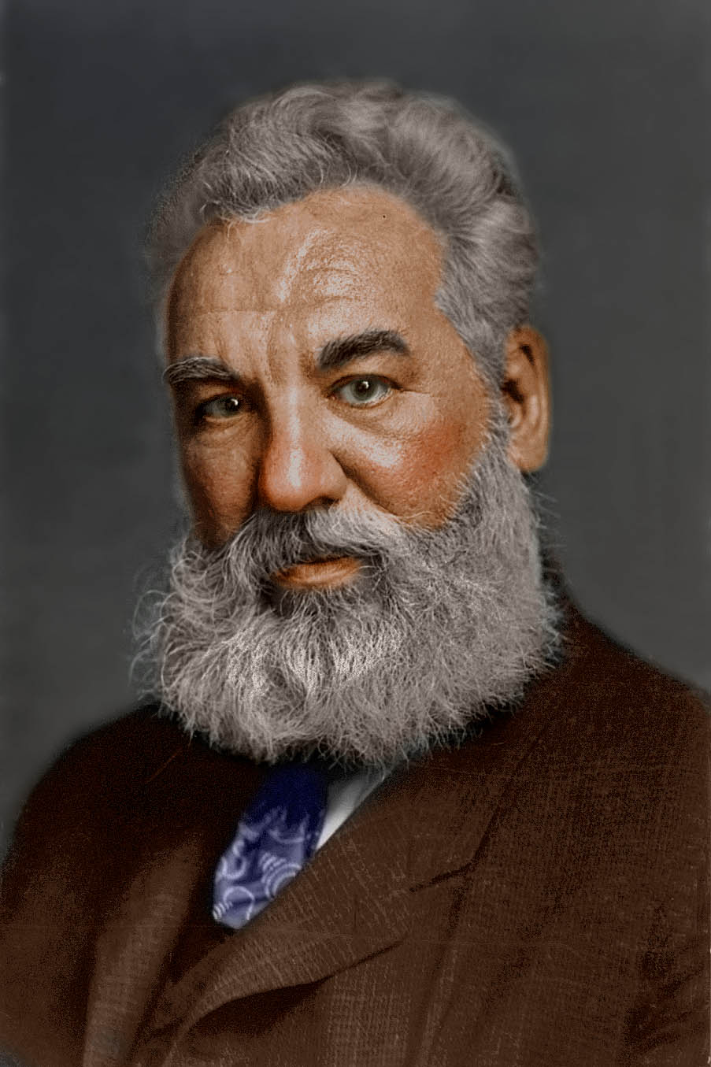
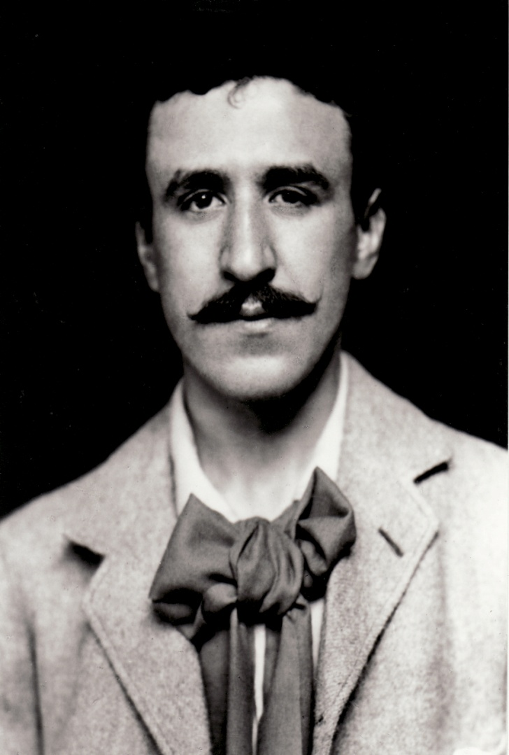
Alexander Graham Bell Charles Mackintosh

Slide 15
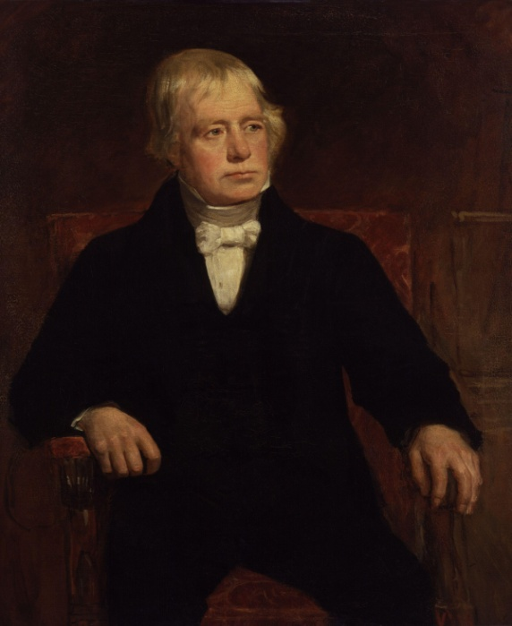
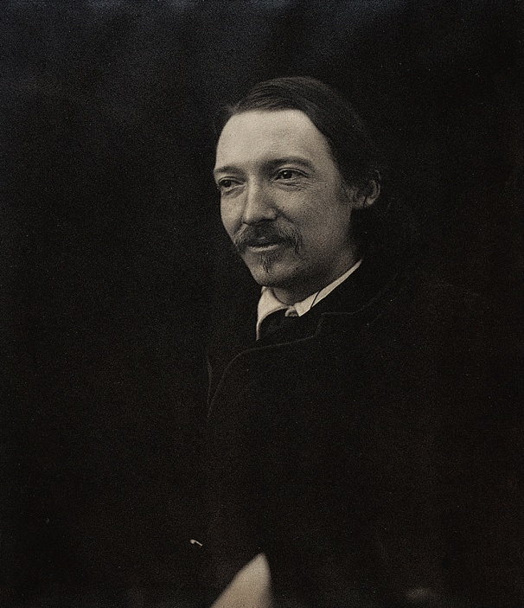
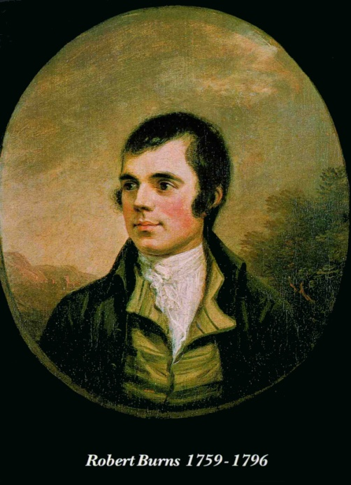
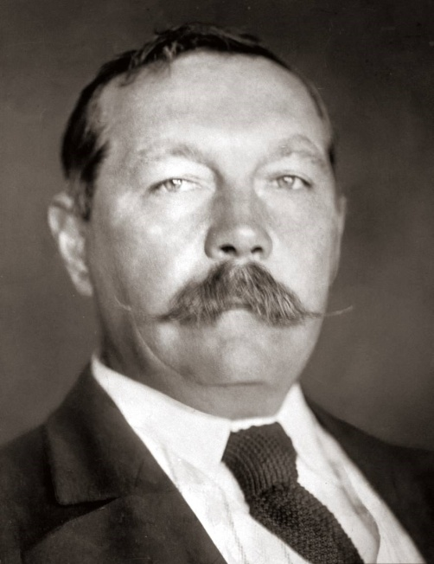
Sir Walter Scott Robert Louis Stevenson
Sir Arthur Conan Doyle Robert Burns

Slide 16
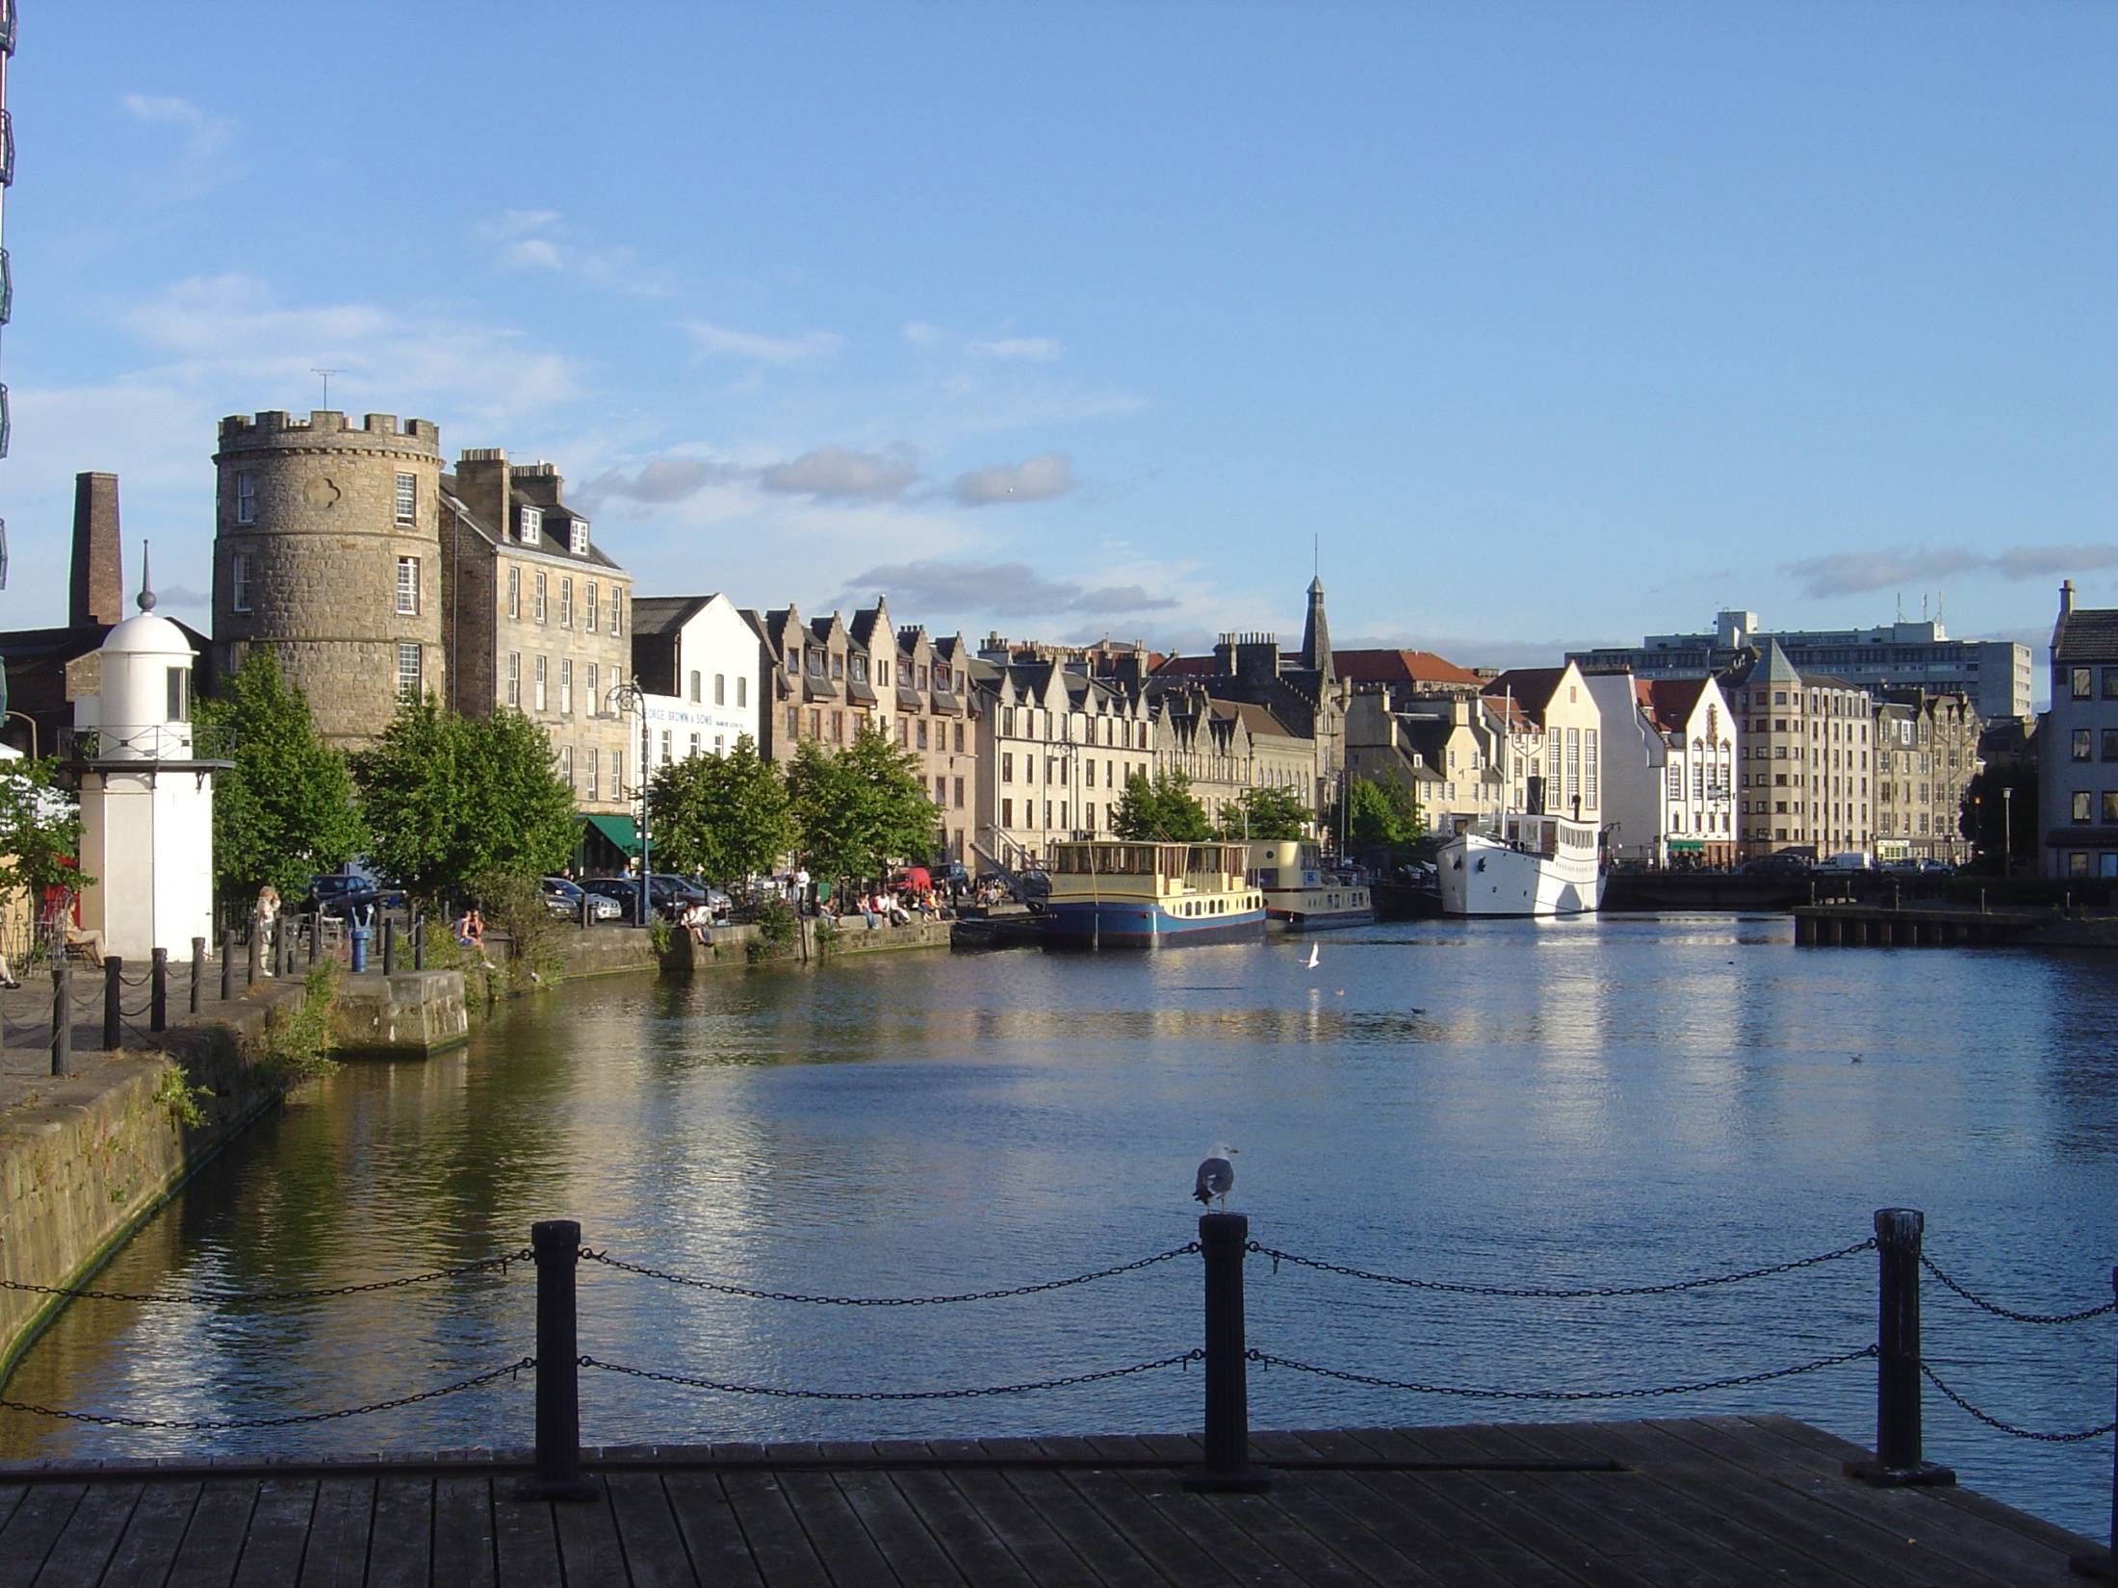

Slide 17
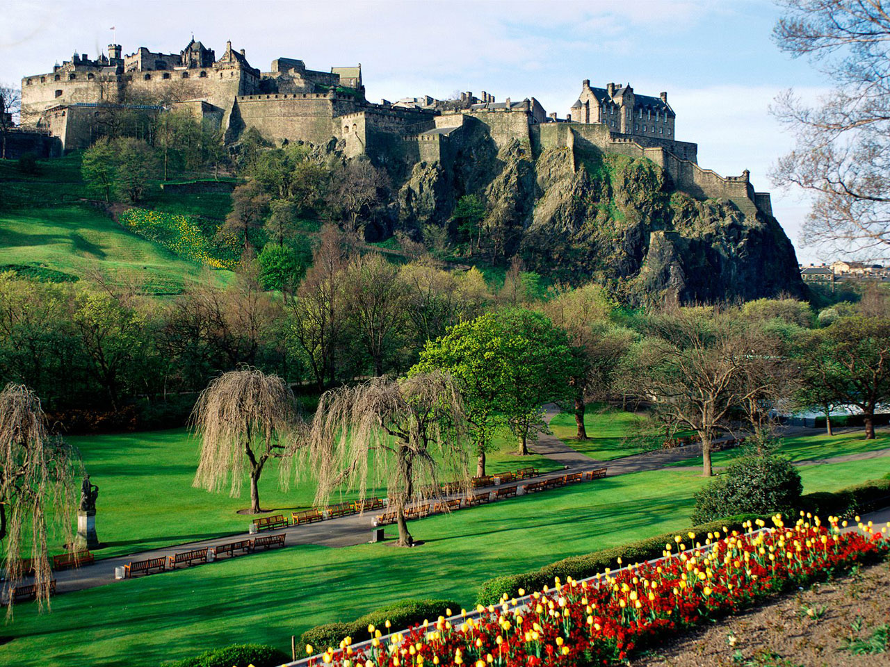

Slide 18
Thanks for watching!
Presentation made by Elena Berbeka
Form 11-B
ME”AEC”DIPLOMAT”

