Slide 1
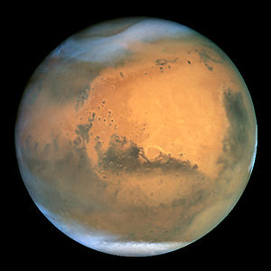
A trip to Mars

Slide 2
Manned mission to Mars - the planned flight to Mars with a manned spacecraft.

Slide 3
Hundred-Year Starship - project permanently sending people to Mars in order to colonize the planet. The project was developed in 2010. The main idea of the project is to send people to Mars forever. This will significantly reduce the cost of the flight, it will be possible to take more cargo and crew. First 'Martians' plan to send to the Red Planet in 2030 already.

Slide 4
A group of scientists and astronauts to Mars delivered with high-tech equipment and a small nuclear reactor can produce oxygen, water and food. Every two years, when Mars will be provided at the desired orbit, NASA will be able to replenish stocks of "colonists" and deliver new astronauts.

Slide 5
Objectives of the future of flight
In addition to the main purpose of flight to Mars - landing several people on the surface of Mars, with the return to Earth, as the objectives of the mission belongs to search for resources outside of the Earth.

Slide 6
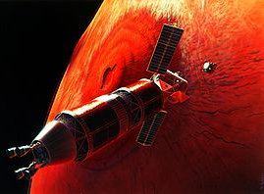

Slide 7
Effects on Astronauts

Slide 8
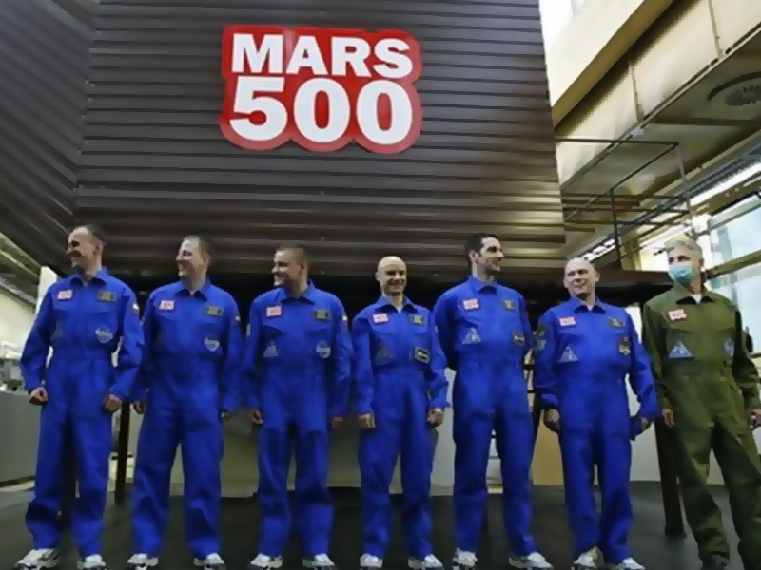

Slide 9
Physiology
Cosmic rays and solar radiation destroy tissues and DNA of the organism. Of the damage is irreversible and can lead to cell mutations.
Prolonged weightlessness during space flight is just the greatest medical problem. Muscles, bones and the circulatory system due to missing gravity become weak if they are not trained.

Slide 10
Physiology
Immediately after hitting man in the weightlessness of his body begins to change. Blood flows to the upper half of the body, and the heart has to do more to pump blood. The body "thinks" that a lot of fluids in the body and begins to secrete hormones that are responsible for water-salt metabolism, resulting in a person loses a lot of fluids. Usually astronaut during this restructuring requires at least 3 liters of water a day. This effect is quite fast

Slide 11
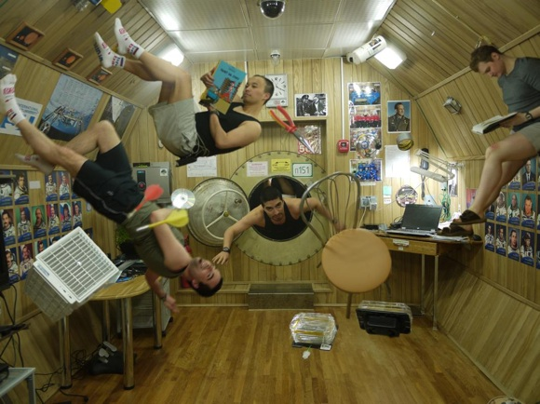

Slide 12
Psychology
The close quarters and limited social contacts become tangible for the cosmonauts. Most often cited aggression, which leads to conflict when people are long in a confined space. This effect can be minimized if the stress-type people in interplanetary crew.

Slide 13
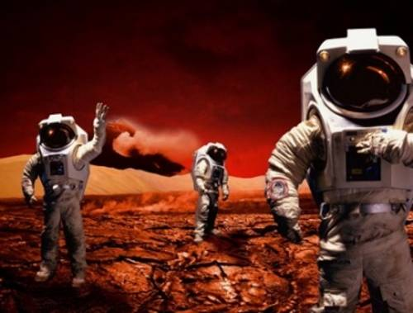

Slide 14
Threatening

Slide 15
Equipment failure
Especially dangerous is the failure of the rocket motor. Each engine has its tanks with a working medium, its control system, its own section of the solar panels. If we consider that electrorocket engines have high reliability, the failure of a number of motors not much effect on the duration of the flight.

Slide 16
Ionizing radiation
An additional problem presented emerging solar flares, which a few days provide increased dose crew. In such cases, the astronauts take cover and protected from ionizing radiation, a special room. Possible violations of health technology, especially computers, and wired communications during this time should be emphasized.

Slide 17
Dust
Martian dust may adversely affect the health of astronauts when hit by light. Due to the very small particle size of it is very difficult to isolate. So the astronauts of the "Apollo" on the next day noticed the presence of dust in the descent module.

Slide 18
The benefits of flying
The flight will be important for human civilization, if one takes the first step to another planet to colonize it later. In addition, the colonization of Mars can play a big role in saving humanity in the case of some global catastrophe on Earth, such as collision with an asteroid. Despite the fact that the probability of such an accident is low, you need to think about it, because the consequences of a global catastrophe could be fatal to the human civilization. Because of the long duration of the process of colonization of other planets, it is best to start as early as possible and to Mars.

