Slide 1
Columbia University
In Thy light shall we see light

Slide 2
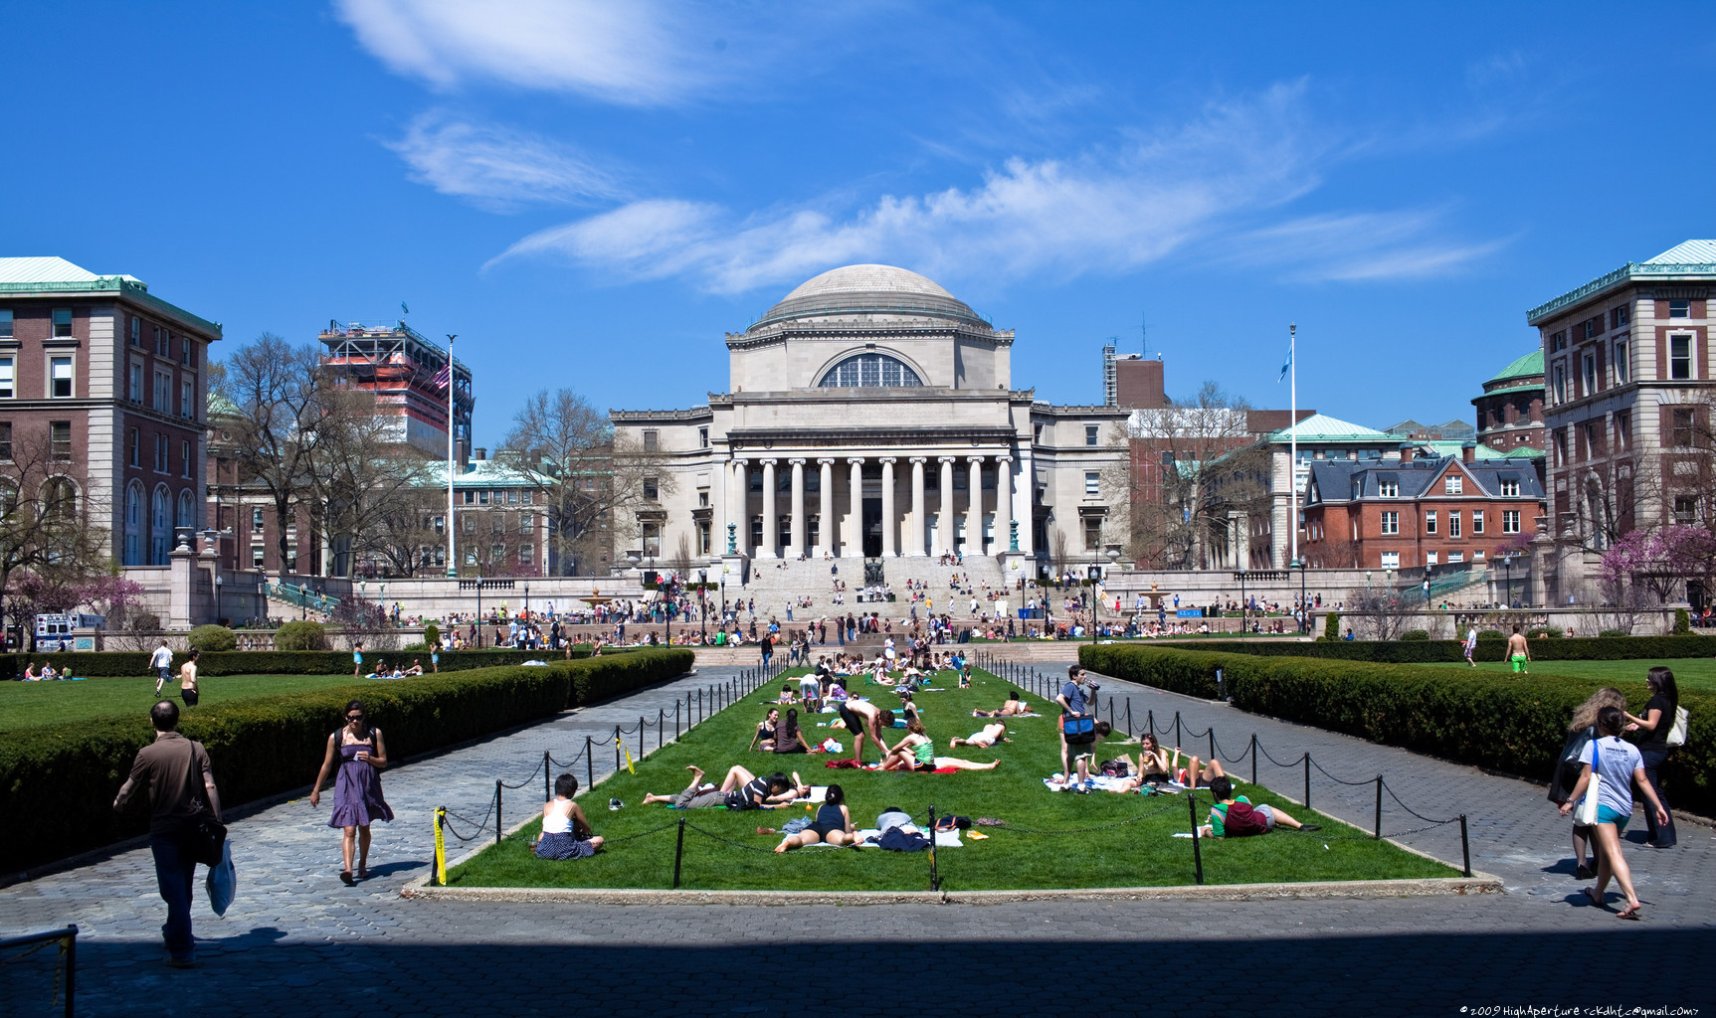
Columbia University in the City of New York, commonly referred to as Columbia University, is an American private Ivy League research university located in New York City. It is the oldest institution of higher learning in the State of New York, the fifth oldest in the United States, and one of the country's nine Colonial Colleges founded before the American Revolution. Today the university operates Columbia Global Centers overseas in Amman, Beijing, Istanbul, Paris, Mumbai, Rio de Janeiro, Santiago and Nairobi

Slide 3
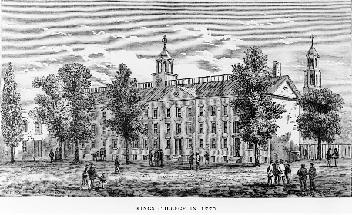
The university was founded in 1754 as King's College by royal charter of George II of Great Britain. After the American Revolutionary War, King's College briefly became a state entity, and was renamed Columbia College in 1784.

Slide 4
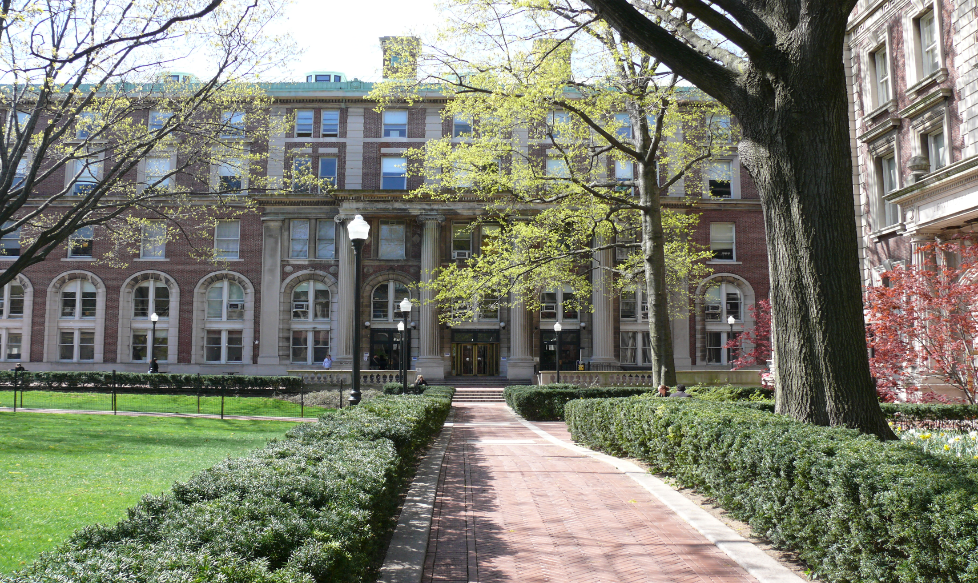
In 1784 it was renamed to Columbia College. During the last half of the 19th century, under the leadership of President F.A.P. Barnard, the institution rapidly assumed the shape of a modern university. By this time, the College's investments in New York real estate became a primary source of steady income for the school, mainly owing to the city's rapidly expanding population.

Slide 5
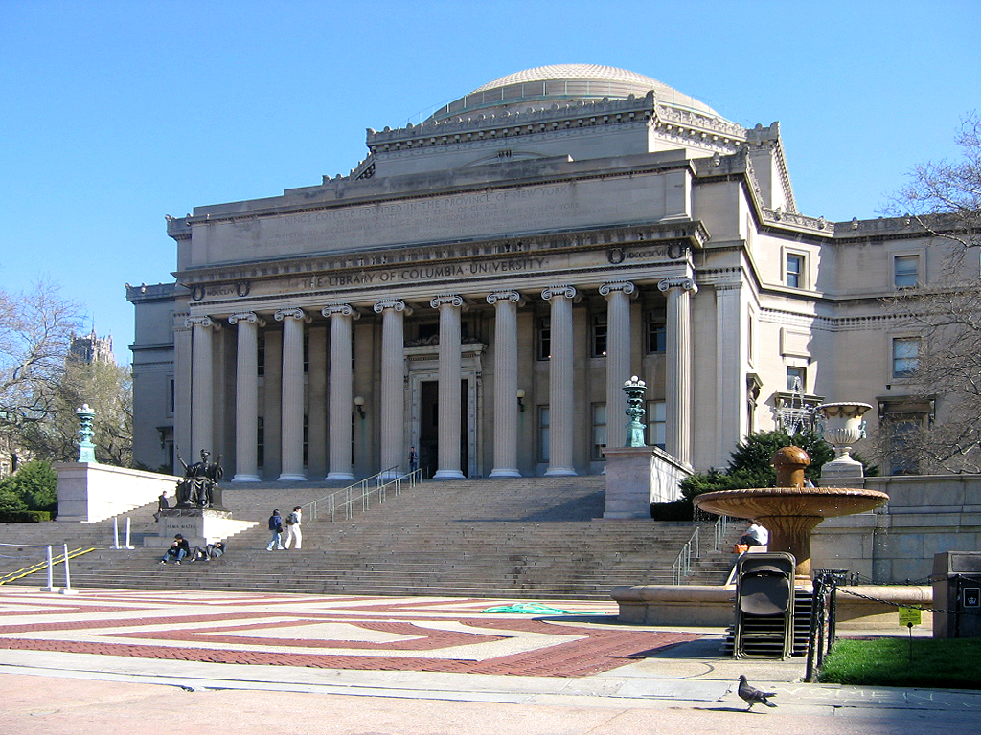
In 1896, the trustees officially authorized the use of yet another new name, Columbia University, and today the institution is officially known as "Columbia University in the City of New York."

Slide 6
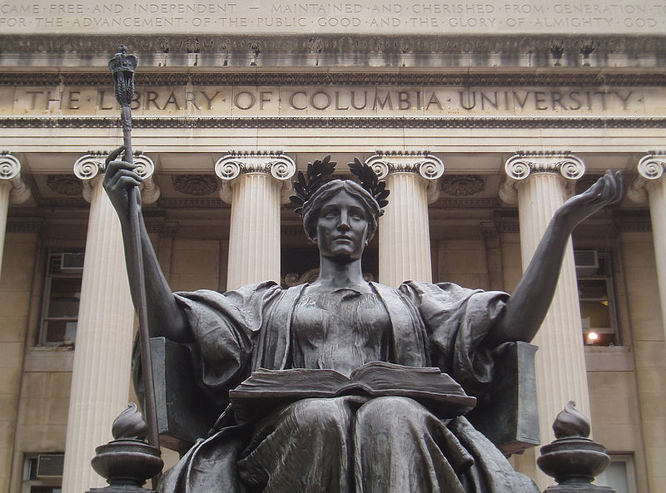
Alma Mater is the name given to a sculpture of the goddess Athena by Daniel Chester French on the outdoor steps leading to Low Memorial Library on the campus of Columbia University in New York City.

Slide 7
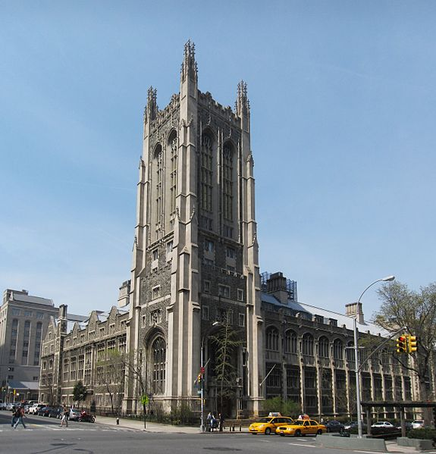
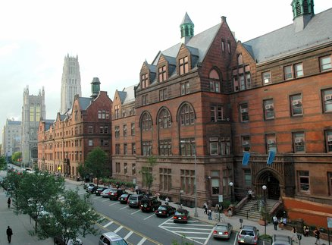
The university encompasses twenty schools and is affiliated with numerous institutions, including Teachers College (which is an academic department of the university, and serves as Columbia's Graduate School of Education), Barnard College, and the Union Theological Seminary, with joint undergraduate programs available through the Jewish Theological Seminary of America as well as the Juilliard School

Slide 8
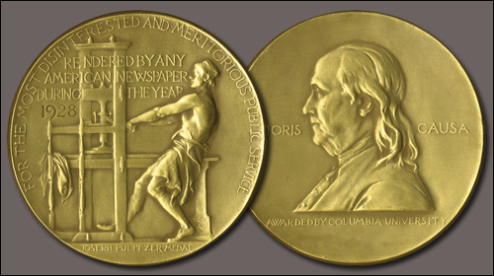
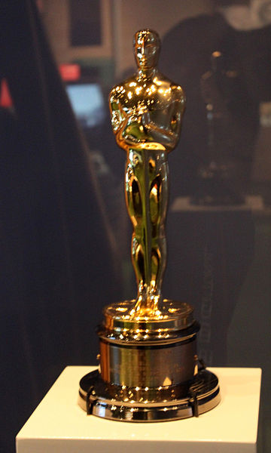
Columbia annually administers the Pulitzer Prize.101 Nobel Prize laureates have been affiliated with the university as students, faculty, or staff. Columbia is one of the fourteen founding members of the Association of American Universities, and was the first school in the United States to grant the M.D. degree.Notable alumni of the university and its predecessor, King's College, include five Founding Fathers of the United States; nine Justices of the United States Supreme Court; 20 living billionaires.26 Academy Award winners and 29 heads of state, including three United States Presidents.

Slide 9
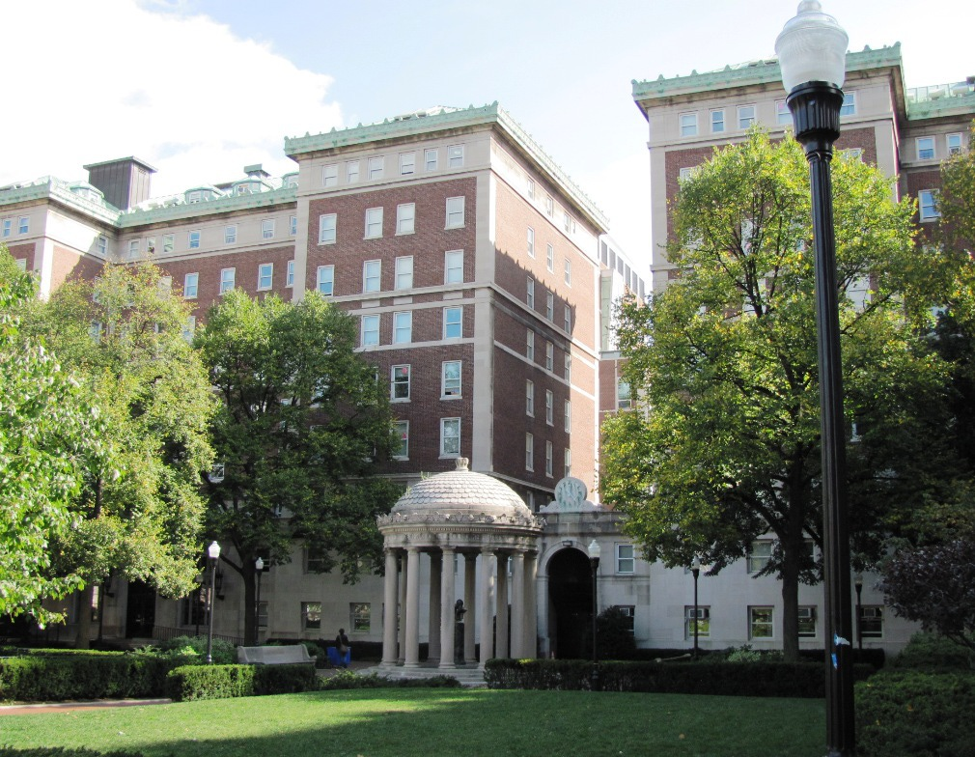
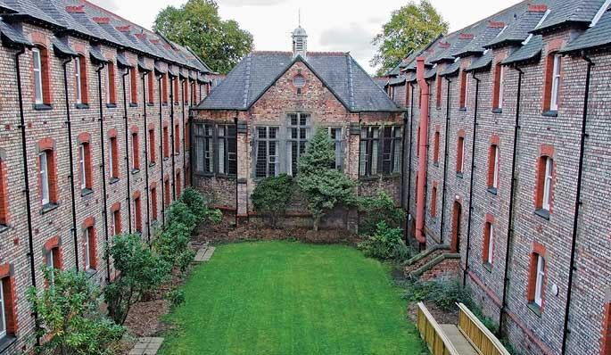
For the 2010 academic year, Columbia University's student population was 27,606, with 35% of the student population identifying themselves as a minority and 23% born outside of the United States.First-year students usually live in one of the large residence halls situated around South Lawn: Hartley Hall, Wallach Hall (originally Livingston Hall), John Jay Hall,

Slide 10
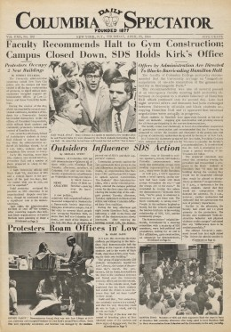
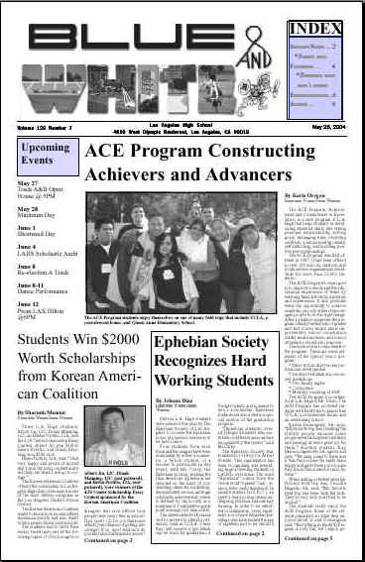
The Columbia Daily Spectator is the nation's second-oldest student newspaper; and The Blue and White, a monthly literary magazine established in 1890, has recently begun to delve into campus life and local politics in print and on its daily blog, dubbed the Bwog.

Slide 11
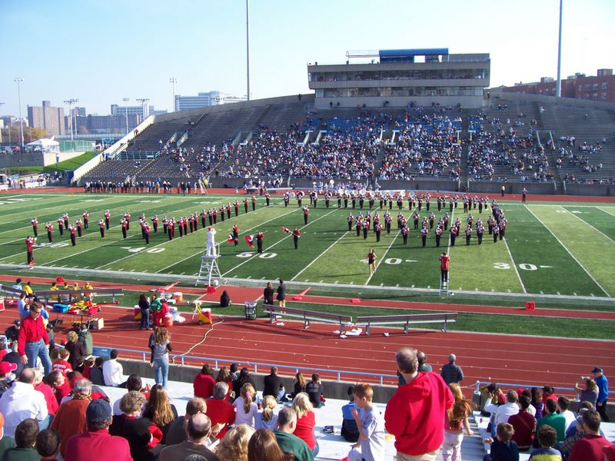

Slide 12
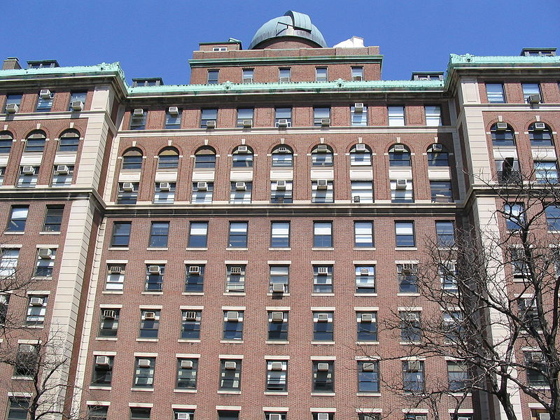

Slide 13
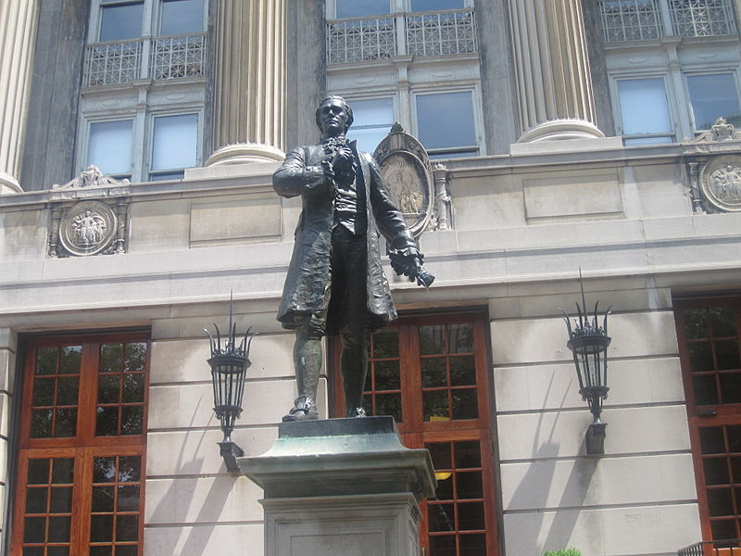

Slide 14
